Slide 1


Welcome
01

Slide 2
Green University of Bangladesh
Presented by, Md. Abdul Kaiyum ID: 201002334 Section: DJ Course: Database System Lab
02

Slide 3
Project Topic
GUB Portal Management System
03

Slide 4
Content Outline
Introduction Project Aim Work Done Work Left
04

Slide 5
Introduction
LogIn panel Student Side Teachers Side Java GUI & My SQL Database
05

Slide 6
Aim
Help teacher and student to do their academic work easily. Try to implement teachers and student’s individual corner. No more lose of time to get all academic support.
06

Slide 7
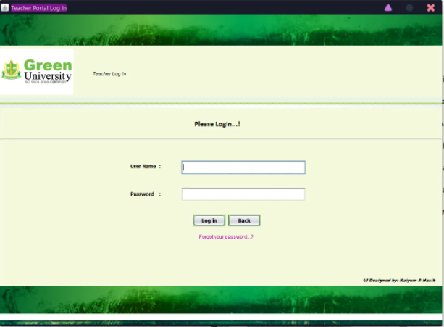
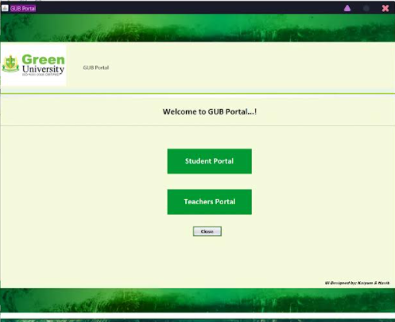
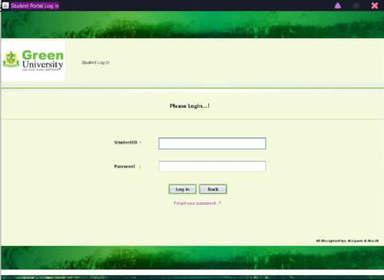
Work Done
07

Slide 8
Work Left
Create Database Connecting with Database Final testing
08

Slide 9
Thank you!
10

